Slide 1
HCI Design Process
Overview

Slide 2
User Research
Objective:
Identify user needs and behaviour
Primary vs secondary
Methods:
Interviews
Online Surveys
Competitor analysis
Notes:
Primary & Secondary

Slide 3
User Research --- Personas
Persona: Alex – The Busy Student
Age: 20
Pain Points:
Forgets deadlines
Dislikes complicated apps
Goals:
Set quick reminders
Stay organized during class

Slide 4
Requirements Analysis
Functional | Non Functional
Add/edit/delete tasks Mark tasks as complete Set due dates Show reminders | Fast performance Minimalist design Offline availability

Slide 5
HTA
HTA breaks down a user goal into sub-goals and operations, organized in a tree structure. It’s more abstract and used in cognitive and task modeling.
🧠 Purpose:
Understand cognitive structure of tasks
Decompose complex actions into smaller parts
Design for task flow logic, not just screens
📄 Format:
Numbered outline or tree diagram

Slide 6
HTA Example
Resetting Password | Create New Task
0. Reset password 0.1 Open login screen 0.2 Select “Forgot Password” 0.3 Submit email 0.4 Open email and click link 0.5 Enter new password 0.6 Confirm password 0.7 Submit | 0. Create a new task 0.1 Open app 0.2 Tap “Add” 0.2.1 Type task 0.2.2 Set due date 0.2.3 Tap save

Slide 7
Design (Low to High fidelity)
Wireframes
User Flows
Shows where the user goes as against HTA what the user does
User Flows are Flowcharts with arrows connecting screens
Represents paths and decision points
Digramming all possible selection

Slide 8
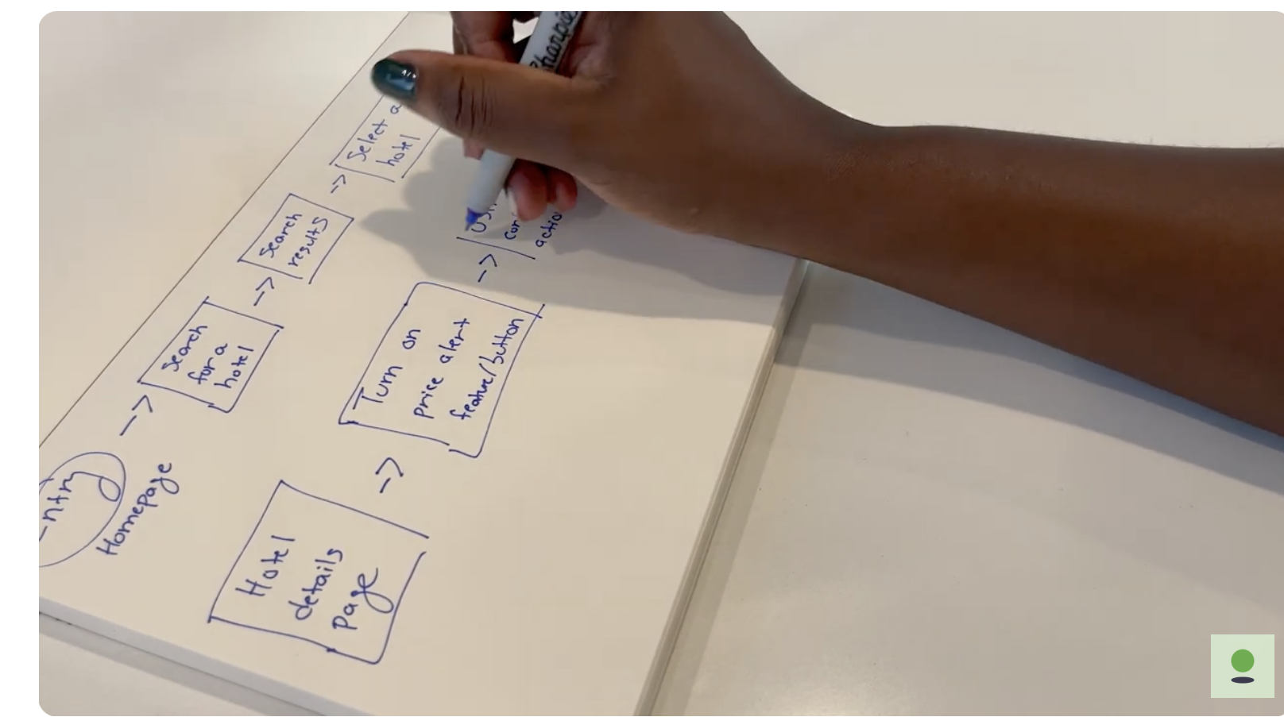

Slide 9
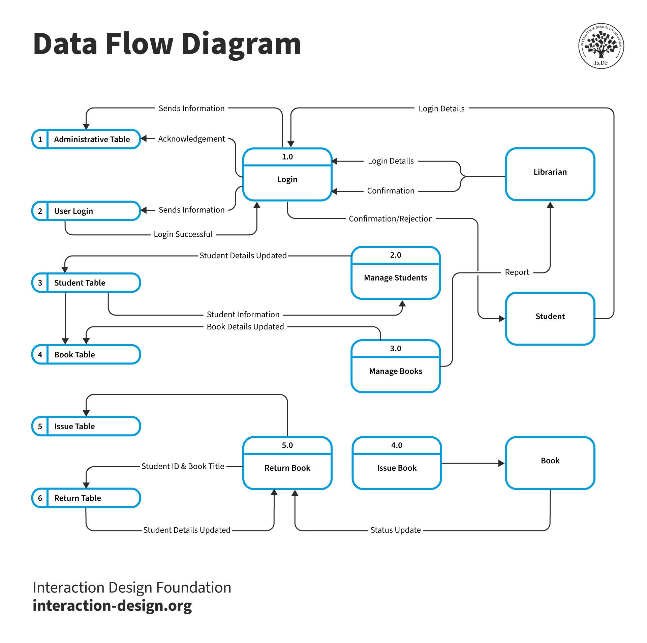
User Flow
Notes:
https://www.interaction-design.org/literature/topics/user-flows?srsltid=AfmBOooZPUEQUU22O346_3e_EVAKg8xr7lrPnGl92JSQswinxutcGrFA

Slide 10
Wireframes
Sketch the screens
Home Screen: List of tasks
Add Task Screen: Text field, due date picker, “Save” button
Reminders Screen: Upcoming tasks (These are black-and-white, no styling yet)

Slide 11
User Flows
Example: "Add a Task"
Open App
Tap “+” Button
Type Task Name
Set Date
Tap “Save”
Task appears on Home

Slide 12
Workflows
Task Creation Workflow:
App receives input → validates fields → stores task in local database → updates UI

Slide 13
Hi Fidelity Prototyping
Using Figma, design visually polished screens:
Use color, iconography, fonts
Add microinteractions (e.g., button press animations)
Use design systems (Material Design, iOS Human Interface Guidelines)

Slide 14
Evaluation
A/B Testing
Usability Testing

Slide 15
Evaluation – Usability Testing
Method:
Ask 5 users to complete tasks like “Add a new task for tomorrow.”
Observe:
Were users confused by any labels?
Did they miss any key buttons?
How long did tasks take?
Feedback Example:
"I thought I had saved the task, but it didn’t show up."
→ Insight: Add a confirmation or feedback animation.

Slide 16
Evaluation – A/B Testing
Comparison between design choices
Button Position
Variant A: “+ Add Task” at top-right
Variant B: Floating Action Button (FAB) at bottom-center
Result:
FAB had 20% higher task creation rate

Slide 17
Implementation & Iteration

